Slide 1
Elixir is better than C# and Java?

Slide 2
OVERVIEW
History
Language features
Platform features

Slide 3
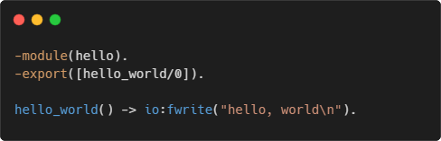
It all started with erlang
Developed in the 1980s by Ericsson
Suitable for telecoms
Distributed
Fault-tolerant
Highly-available
Used by WhatsApp, RabbitMQ
Runs on BEAM virtual machine

Slide 4
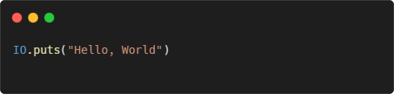
Enter elixir
Created in 2012 by Jose Valim
Runs on BEAM as well
Used by Discord and Pinterest
Main features
Functional paradigm
Immutable data structures
Pattern matching
REPL and documentation as first-class citizen

Slide 5
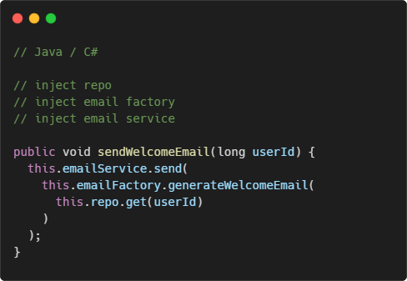
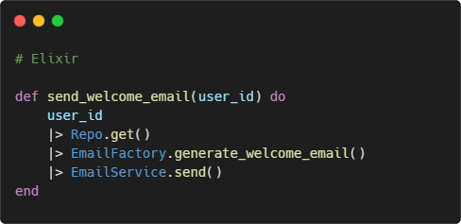
Functional programming
Focus on actions, not on objects and instances

Slide 6
The concept of OOP
The term is coined by Alan Kay (a biologist) in the 1960s
Simulating the cells in living organisms
Cells have isolated internal states (data)
Decoupled from each other
Communicate through messages

Slide 7
Where are the classes?
“OOP to me means only messaging, local retention and protection and hiding of state-process, and extreme late-binding of all things.” – Alan Kay
“If I could do Java over again, I would leave out classes.” – James Gosling
It’s about encapsulation and message passing

Slide 8
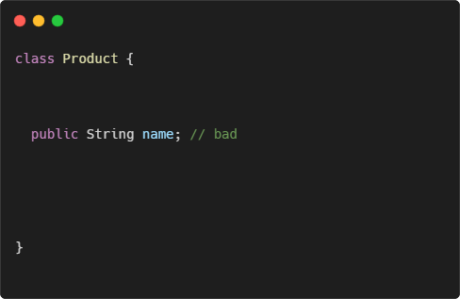
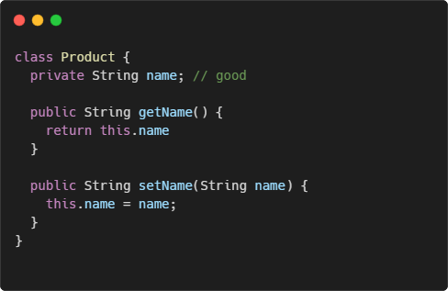
Let’s talk about encapsulation
What’s the difference?

Slide 9
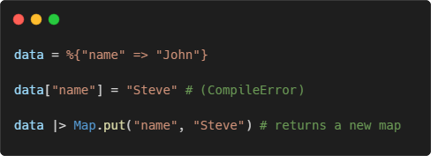
The real encapsulation
Avoiding shared mutable state
Reduce side effects
Less bugs
Forget about getters and setters
In Elixir, everything is immutable!
Records in Java/C# are step in the right direction

Slide 10
Pattern matching
A technique popular in functional languages
Test whether the object matches a given expression
Used for cleaner control flow statements
See demo

Slide 11

Demo

Slide 12
REPL and doctests
Elixir has a built-in REPL (Read–eval–print loop)
Can execute simple expressions
Can be started as part of the project
Can be attached to a running project
Doctests
A mix between unit tests and documentation
Help keeping the documentation up to date

Slide 13
Demo

Slide 14
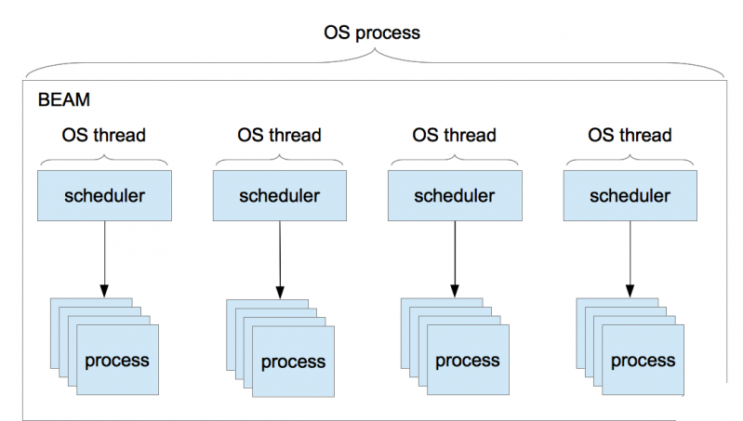
BEAM concurrency model
BEAM VM has its own scheduler
Runs lightweight processes instead of OS threads
No shared state between processes
Communication is done via message passing

Slide 15
Concurrency model benefits
Better performance (no locks)
Fault tolerance
Scalability – up to ~268M running processes

